Slide 1
AI-Hackathon 2021 Team #3
Notes:
Hello everyone. This is the presentation of Team number three

Slide 2



Team #3
Abol Taghribi
AI-expert
Alireza Zolanvari
Data analyst
Zahraa Al Sahili
AI-expert
Notes:
And we are team number three

Slide 3


Objective
1. Before pandemic
In case of a pandemic, which types of countries are more at risk?
2. During pandemic
Do we really save lives by staying at home?
Notes:
Our objective during this challenge was to answer two main questions.
First, which types of countries are more vulnerable facing a pandemic
Second, Is really staying at home an effective policy for controlling such pandemic?

Slide 4
1.
Countries analysis A statistical study on OWID dataset
Notes:
To answer the first question, we perform a statistical analysis on society-related features provided on OWID dataset

Slide 5

Features
Population
Average age
Smoker
Income
Life expectancy
Hospital beds
Handwashing facilities
etc.
Notes:
Like population, average age and so on which has only one value per each country to find out if there is any specific relation between these characteristics of countries and the number of cases and deaths

Slide 6
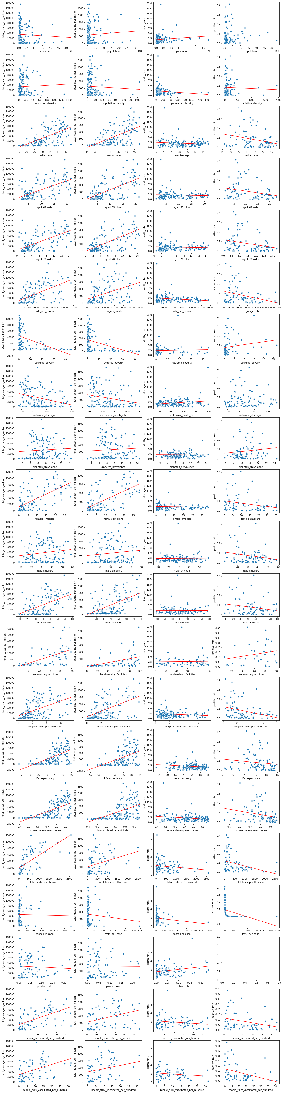
Features’ plot
Notes:
For this, after cleaning data, we plotted number of cases and deaths per million vs each of these features one by one. Each point represents a country a the line tries to show the trend if there is any. These are some of our plots

Slide 7
Remarkable results
Predictable
Interesting
Strange
Notes:
After taking a close look on theses plots, we faced some predictable results: older societies are more infected; some interesting results: societies with higher number of female smokers, reported more cases; and some strange results: countries with higher income and better health infrastructure are more affected by COVID.

Slide 8
Hypotheses
Inaccurate reports
The reported number of cases in low-income countries are not much accurate
Hidden features
Some other features are playing the main role but we see only their impact through these strange features.
Notes:
To interpret these strange, we came up with two hypotheses.

Slide 9
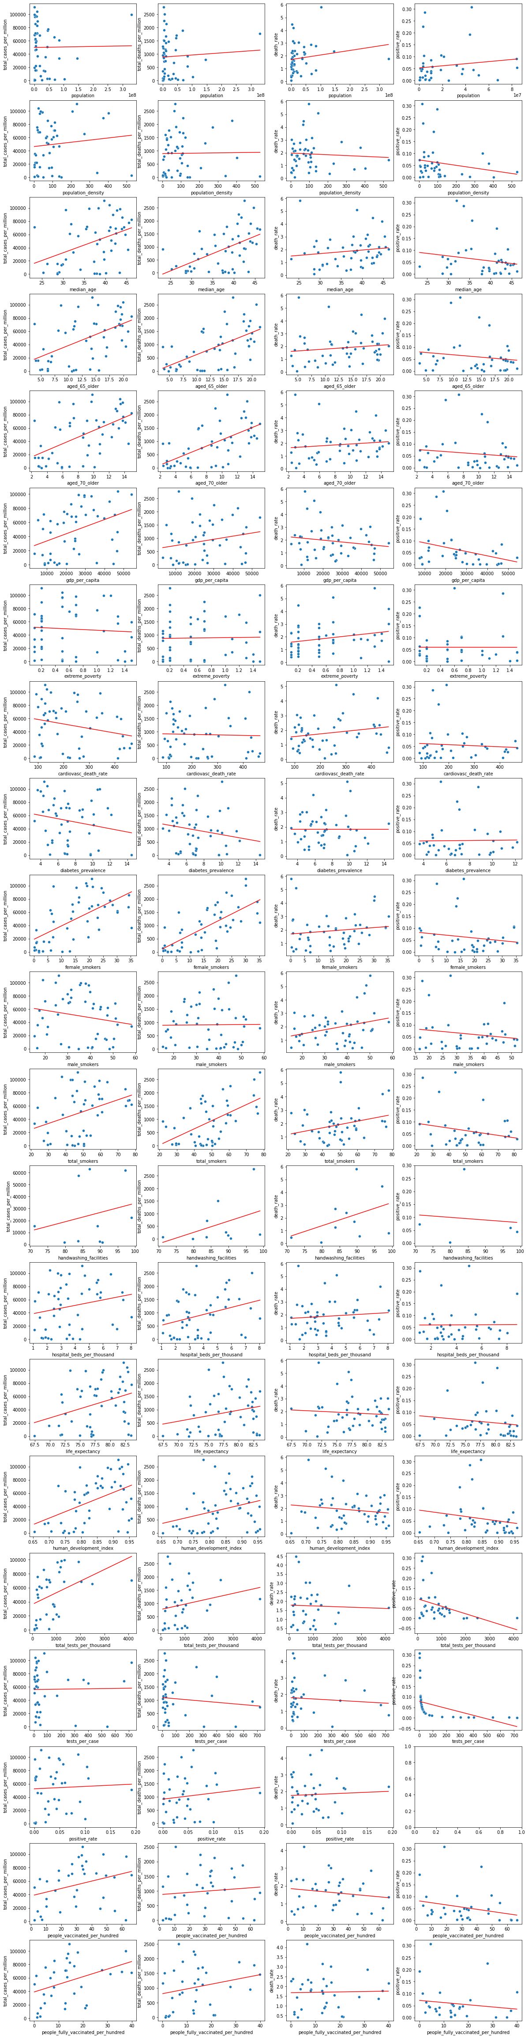
Plots for top high-income countries
Notes:
For validating the first hypothesis, we repeated generating that plots for top %50 countries with higher incomes. As you can see somehow the results are repeated. So, our first hypothesis is not strong enough

Slide 10
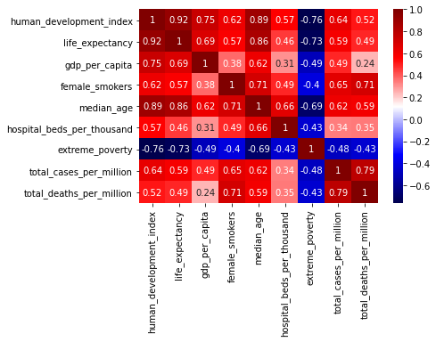
Correlation matrix
Notes:
For testing the second hypothesis, we tried to find the hidden features among the features which are highly correlated with the strange features. Logically, these kind of features can show their impact through the strange features, if there is any. And this is our observation.
As you can see, high-income countries are more aged, the countries who have more female smokers are ages, and at last low-income countries are young. So it seems, that hidden feature is age.

Slide 11
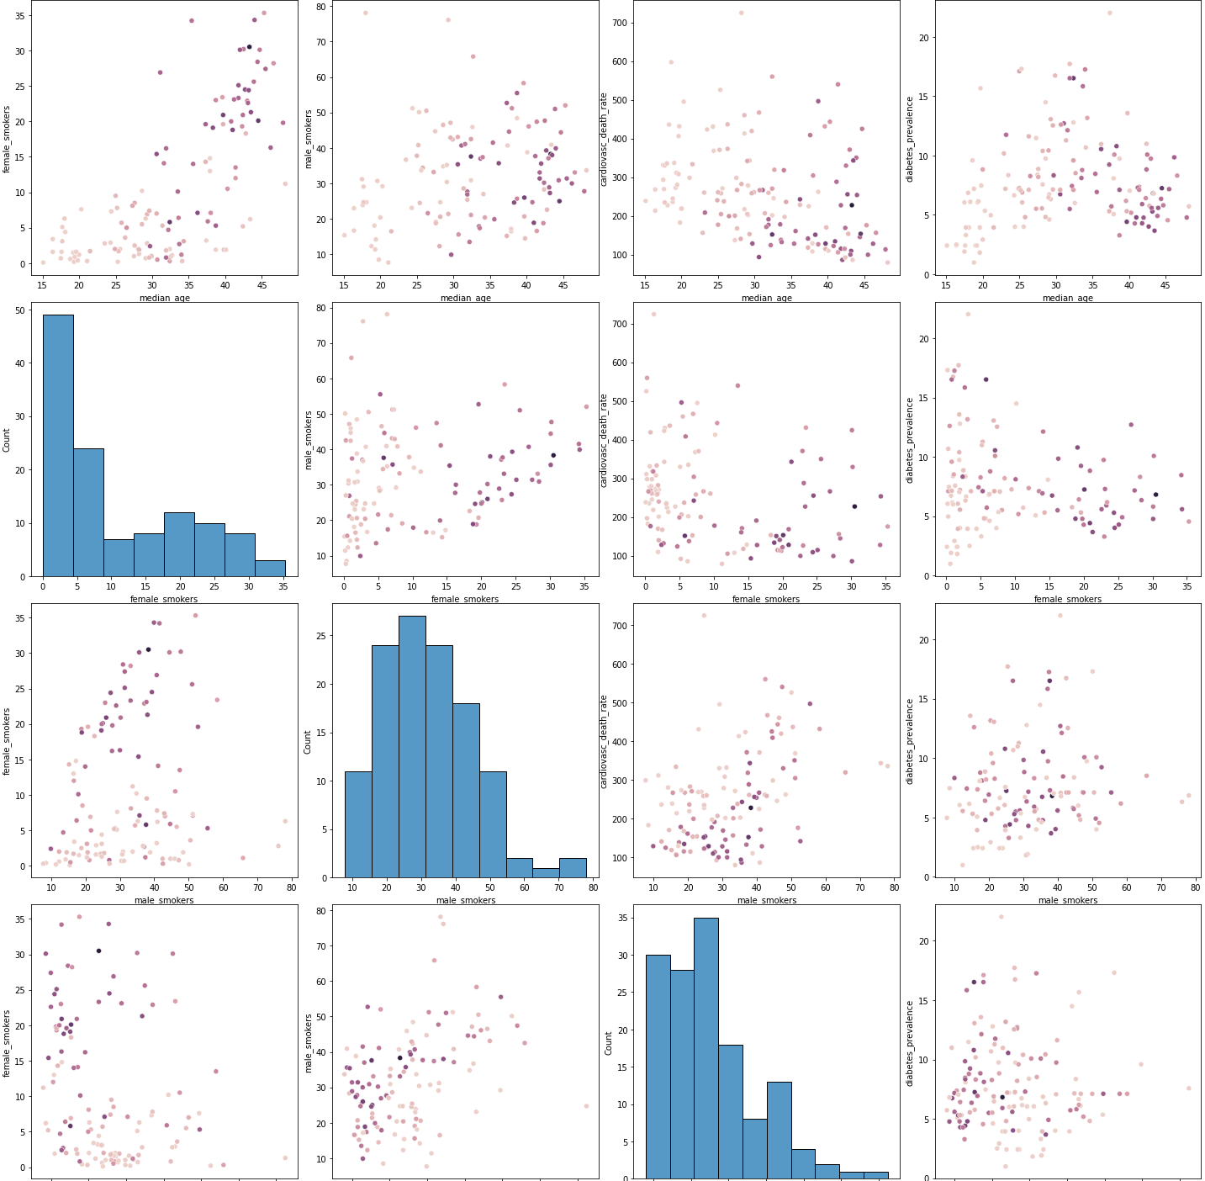
Correlation matrix
Notes:
We also investigated the impact of two by two combination these features on number of cases and deaths. Again in this investigation, the only dominating feature is age.

Slide 12

In case of a pandemic, which types of countries are more at risk?
Aged societies
Notes:
Let’s return to this question. And the answer is

Slide 13
2.
Policies analysis A time-series analysis on OxCGRT dataset
Notes:
Now we can go for answering the second question. We performed a time-series analysis over the oxford dataset to evaluate the impact of stay-at home policies.

Slide 14
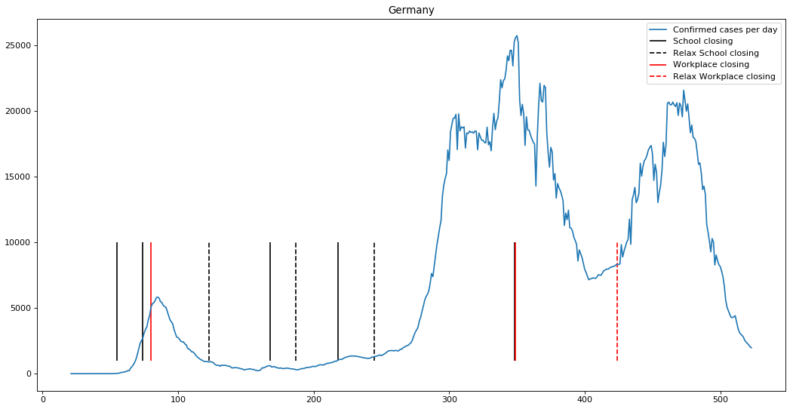
Confirmed cases during time (Germany)
Notes:
Let’s take a look on the number of cases in Germany during the time. These solid lines show when the school or workplace closing policies were applied and the dashed lines show when the are relaxed. It’s visually obvious that a bit after applying the policies, the number of cases decrease. But are these decreases really the result of the policies? What would happen if we didn’t apply such policies?

Slide 15
Model predictive analysis (Germany)
Notes:
To show and somehow evaluate the impact of each policy, our idea is to break the data into two parts from the date that the policy had been applied. Use the data before that date to train a model to learn the trend of the data and then predict the next thirty days using that model. Comparing the actual values to the predicted ones can show that how much the policy was effective at that time. For that we used Prophet algorithm introduced by facebook in 2017 for forecasting time-series to predict events. For example here we used these black points to train our model, and forecast what would happen if that trend continued. As you can see, the actual data (the blue points) follows our predicted trend in about three weeks after applying the school closure policy. Not much effective!

Slide 16
Model predictive analysis (Germany)
Notes:
But a few days after adding workplace closure to the policies the trend of data changed and it is not following our predicted trend. The combination of these two policies seems effective.

Slide 17
Model predictive analysis (Netherlands)
Notes:
This model is not reliable all the times because we don’t have a comprehensive information in this data set. For example here, although our model predict that the trend is decreasing after applying this policy, but most likely because of the British variant the number of cases increased and we don’t have this information in our model to consider it.

Slide 18
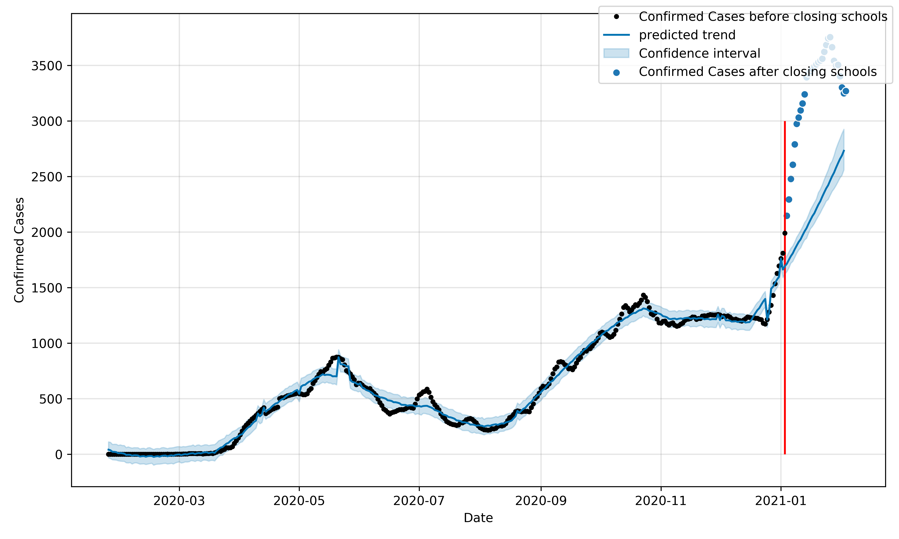
Model predictive analysis
Malawi
Netherlands
UAE
Germany
Notes:
We repeat our study on few other countries and get same results.

Slide 19

Do we really save lives by staying at home?
Yes! We are heroes who save many lives by staying at home
Notes:
Coming back to this question.

Slide 20
Thanks!
Any questions?

